Slide 1
﻿
Diagnosing pneumonia
Carolina Gonzalez

Slide 2
Business Case
Pneumonia is the world’s leading cause of death among children under 5 years of age.
In the US, pneumonia was one of the top ten most expensive conditions seen during inpatient hospitalizations.
Chest X-rays are the most common imaging examination tool used in practice
There is a shortage of experts who can interpret X-rays
Notes:
Pneumonia is the world’s leading cause of death among children under 5 years of age, accounting for 15% of all deaths of children under 5 years old.
In 2011, pneumonia had an aggregate cost of nearly $10.6 billion for 1.1 million hospital stays.

Slide 3
Data
Pneumonia
Positive image
25684 labelled X-rays
Coordinates for boxes indicating location of pneumonia for positive images
20025 no pneumonia images
Pneumonia
Negative image

Slide 4
Model
Neural Networks Transfer learning:
VGG16
ResNet50
Object location system, yolo

Slide 5

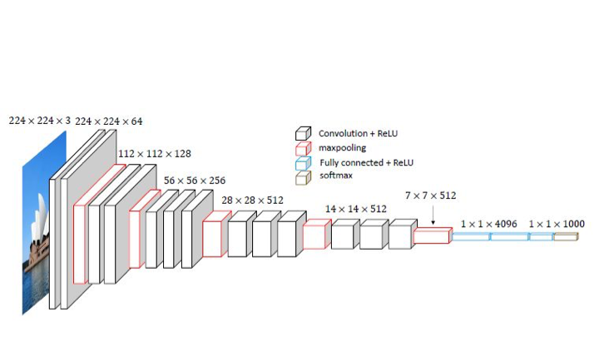
VGG16 architecture
Sigmoid

Slide 6
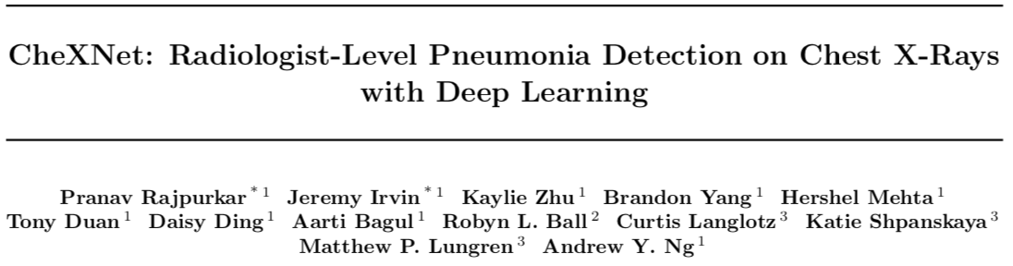
Evaluation of performance
 | F1 Score
Radiologist 1 | 0.383
Radiologist 2 | 0.356
Radiologist 3 | 0.365
Radiologist 4 | 0.442
Radiologist avg. | 0.387
Model | 0.573

Slide 7
Conclusions
Transfer learning was used for predicting pneumonia based on chest X-rays data only.
The results showed an improvement over radiologists performance without metadata.
Future work:
Inclusion of metadata such as patient temperature,
presence of coughing, chest or lateral pain.

Slide 8
Questions
m_carolina_g@yahoo.com
mcarolinag
in carolinagonzalezseattle
mcarolinag.github.io

Slide 9
Apendix

Slide 10
Diagnosis challenges
Pneumonia can be caused by viruses, bacteria or fungi.
The images of pneumonia caused by different causes may look slightly different.
The diagnosis currently takes into account symptoms and X-rays.
The treatment (antibiotics) selected is based characteristics of X-rays and symptoms.

